Slide 1
Connections relating to the habitability of Mars
Robbie Freeman
Ugne Kucinskaite

Slide 2
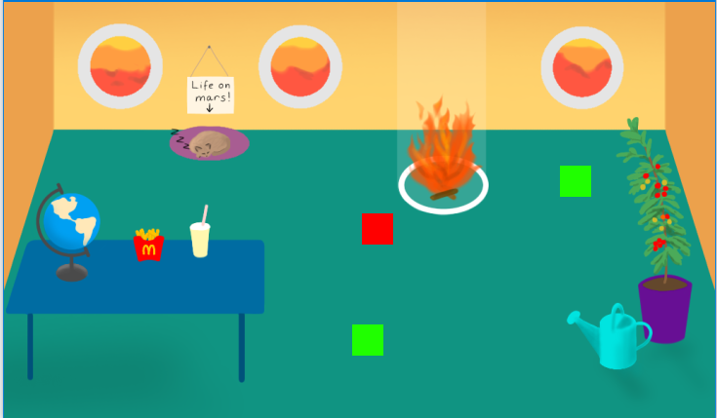
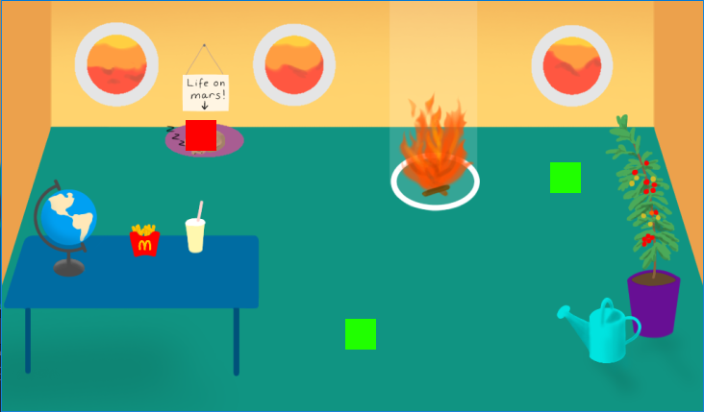
This demonstration uses placeholder sprites for the player and the objects. The player is the red square, and the reusable object components are the green squares. The sprites can be changed in the godot editor
By clicking on the cat bed, the player moves over to the cat

Slide 3
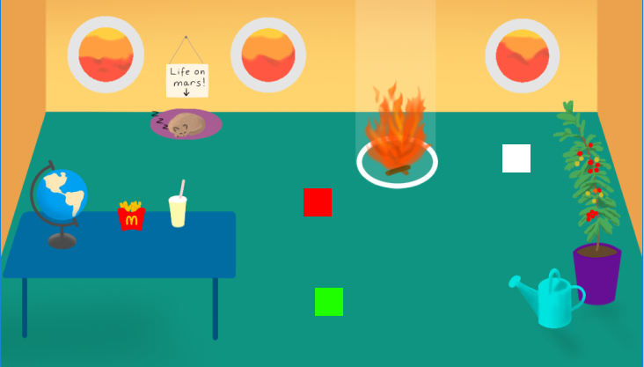
When the mouse hovers over an object, the object lights up in the shape of the sprite as shown below. This indicates that the object is interactive

Slide 4
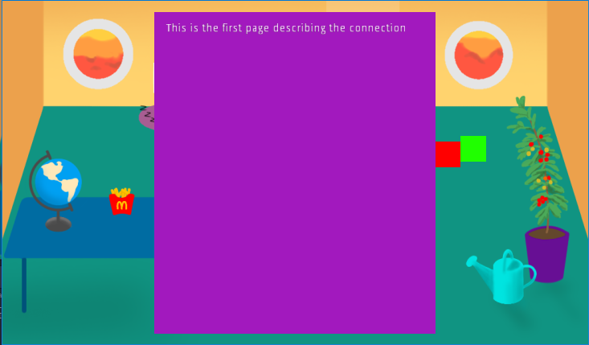
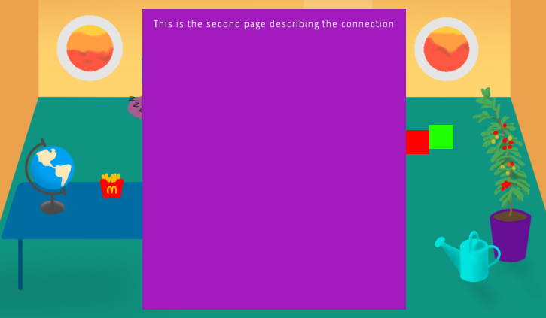
When the player clicks on and reaches the object, a text box will be displayed shown below in purple. The contents of this text box can be modified easily for each individual object using the editor.
If the player clicks anywhere on the screen, the next page is shown. The player does not move

Slide 5
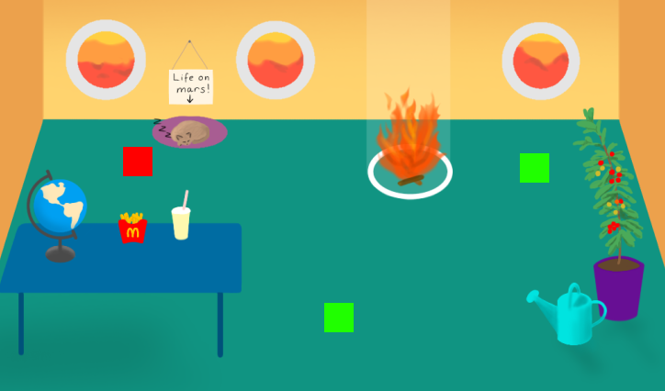
Once the player has read every page of the text box, the box will disappear and the player will be free to move again

Slide 6



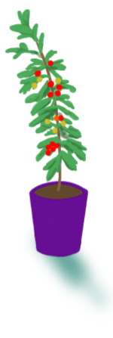

Capillary action was represented by a cup with a straw because capillary action occurs in straws and other narrow tubes like plant stems.
Heliophysics and habitability is represented by a window looking over Martian terrain because it represents the fact that Martian atmosphere is potentially habitable.
Combustion was represented by a fire because the combustion process is often associated with burning.
Each connection we made had an object associated with it in the experience.
Growing crops in microgravity was represented by a tomato plant because that is one of the crops NASA are hoping to add to the list of edible foods grown in space.
‘What makes a perfect planet for life?’ is represented by a globe because Earth is currently the only known planet to host life.

